Slide 1
MCSB 2025 DryLab Module 2: Dynamical models, parameters, simulation, prediction Prof. Elizabeth Read August 26, 2025
Learning Goals:
Intro to the historical role of modeling in biology and current discussions in the field
Introduction to key concepts and terms for dynamical systems models (high level)
Discrete-time modeling exercise: “hands-on” experience with parameters, simulation, prediction

Slide 2

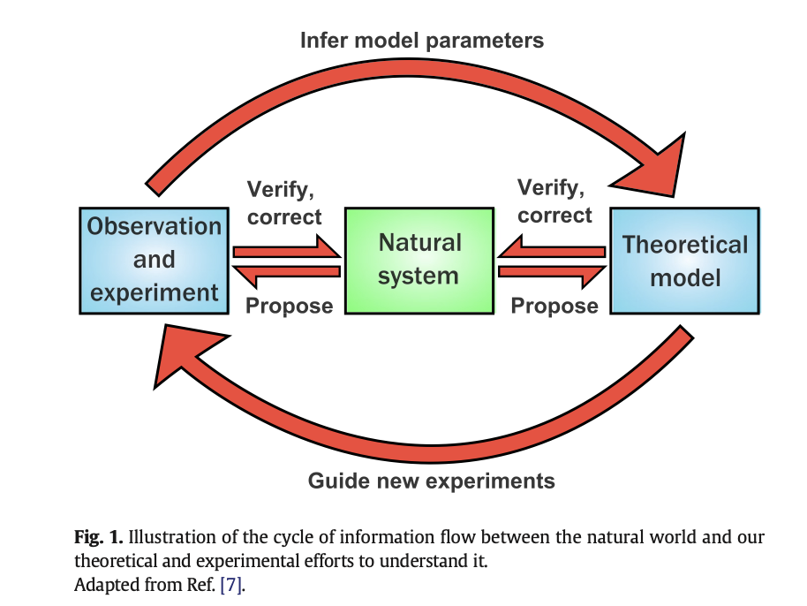
Excerpts from the literature… Why build models for biology?
2014
Models are useful for many different purposes: perhaps the most important of these are crystallising our assumptions and testing them, guiding experiments and looking at experimentally unreachable scenarios [5], as well as the much-vaunted ability to make new predictions [6]. Ideally, there should be a virtuous cycle between experiment and theory to understand the natural system in which we are interested [7] (Fig. 1).
If the model and experiments agree, then parameters for the model can be inferred from the data and the model refined, again leading to further experiments
(large arrows, Fig. 1). If they do not agree, this implies that the hypothesis was inappropriate: the model needs revision, and theoretical tests using different models can provide a starting point for further experiments. For this we need to go back to our natural system and propose revisions (major or minor) to the model and new avenues for experiment, as well as verifying our findings (small arrows, Fig. 1).

Slide 3
Excerpts from the literature… Why build models for biology?
2014
A model is an abstract representation of the system in which we are interested, usually formulated mathematically. This model can, in simple cases, be solved analytically for a particular question, giving us an exact analytical solution to the question posed to the model. In general, however, analytical solutions for all but the most simple models do not exist, and we have to resort to methods to solve the model numerically. These give rise to numerical solutions, which are approximations to the analytical solution that become more and more accurate as we use smaller and smaller numerical steps … Numerical solutions are (nowadays) evaluated computationally because they are very time-consuming to carry out by hand. In many cases, the numerical solution will try to mimic the behaviour of the real system over time— this is a simulation.
(Example: flight simulator).
(Key terms)

Slide 4
Excerpts from the literature… Why build models for biology?
2014
An important point to remember when we talk about mathematical models is that, in a sense, “all models are wrong” [8]. This does not mean their conclusions or predictions are false— as the famous quote continues, “but some are useful” [8]; rather, we should bear in mind that all models are abstractions of reality, simplified versions of the real systems that they represent. A model is a vehicle for gaining understanding [6], and we would not gain any new understanding from a model that was as complicated as the real system … Almost all models are phenomenological; that is, they are based on a set of simplified assumptions that we have distilled from the real system using intuition rather than rigorous proof from basic principles [9]. Incorporating only the important ones allows us to crystallise our understanding of the system (and if the model gives wrong results, we know that our assumptions were wrong or incomplete). Creating phenomenological models is not a trivial task: “sensing which assumptions might be critical and which irrelevant to the question at hand is the art of modeling” [10].

Slide 5
Excerpts from the literature… Why build models for biology?
2014
An important point to remember when we talk about mathematical models is that, in a sense, “all models are wrong” [8]. This does not mean their conclusions or predictions are false— as the famous quote continues, “but some are useful” [8]; rather, we should bear in mind that all models are abstractions of reality, simplified versions of the real systems that they represent. A model is a vehicle for gaining understanding [6], and we would not gain any new understanding from a model that was as complicated as the real system … Almost all models are phenomenological; that is, they are based on a set of simplified assumptions that we have distilled from the real system using intuition rather than rigorous proof from basic principles [9]. Incorporating only the important ones allows us to crystallise our understanding of the system (and if the model gives wrong results, we know that our assumptions were wrong or incomplete). Creating phenomenological models is not a trivial task: “sensing which assumptions might be critical and which irrelevant to the question at hand is the art of modeling” [10].
Box GEP. Robustness in the strategy of scientific model building. In: Launer RL, Wilkinson GN, editors. Robustness in statistics. New York: Academic Press; 1979. p. 201–36.

Slide 6
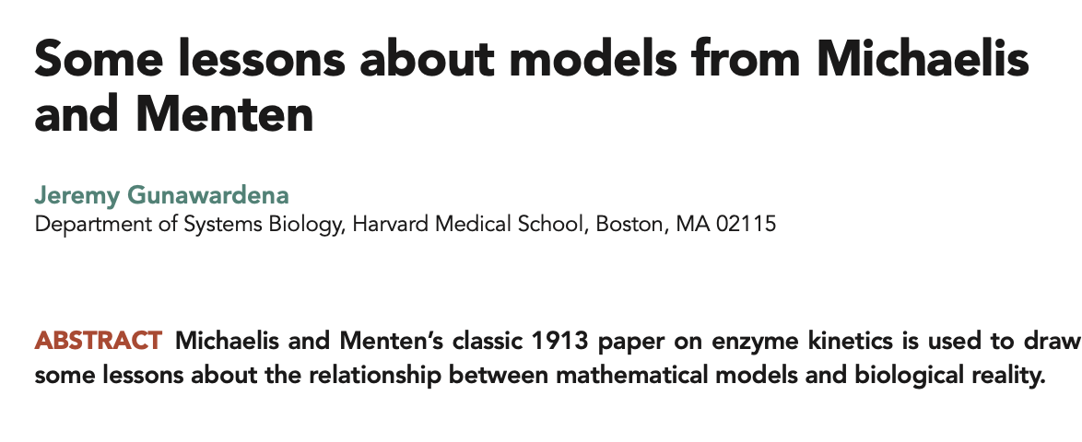
Excerpts from the literature… Why build models for biology?
2012
These days, it is no longer so uncommon to find an experimental paper that includes a mathematical model. This may seem a surprising and perhaps even unwelcome intrusion into the qualitative world of molecular biology. In fact, quantitative methods and mathematical tools have always been used in biology, going back to Harvey’s wonderful demonstration of the circulation of the blood. If this synergy is not widely appreciated, it is because our historical memories are woefully short. In consequence, there is little shared understanding about models.
I coteach, with one of my colleagues, Johan Paulsson, the introductory course in Harvard’s graduate program in systems biology. The students come from an unnervingly broad spectrum of backgrounds in biology and the physical sciences, and one of the trickiest issues is how to get across what a model is and what one can, and cannot, expect from it.

Slide 7
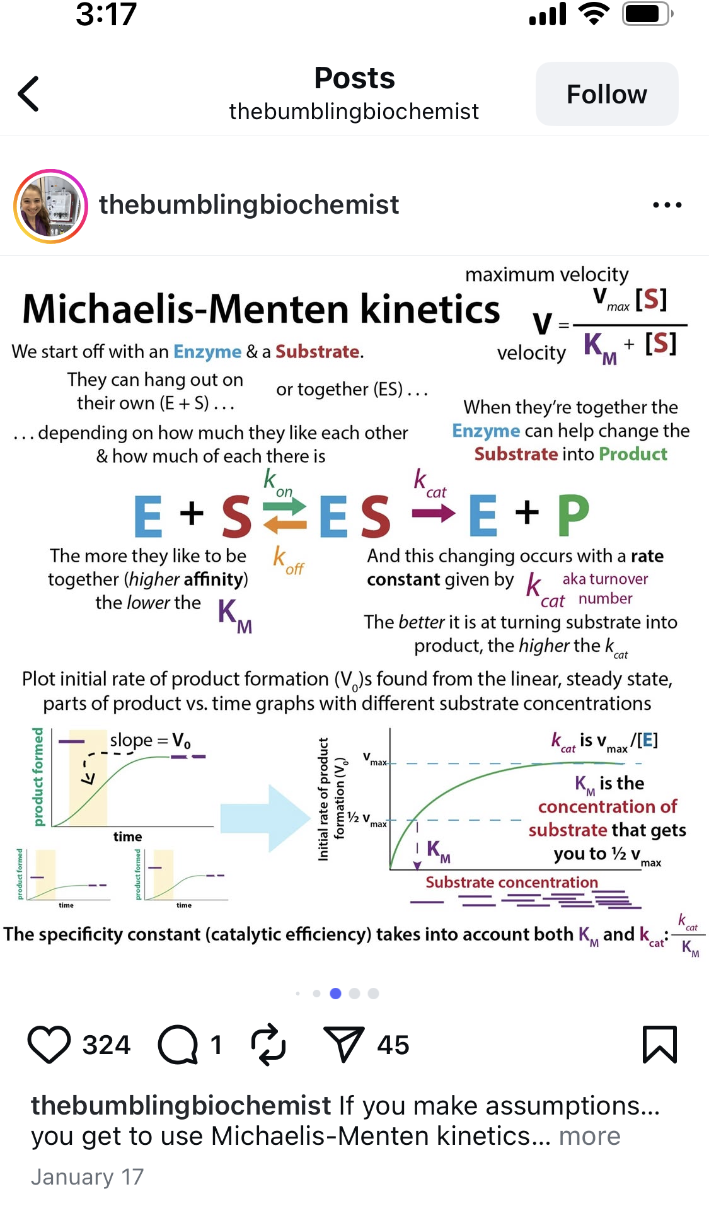
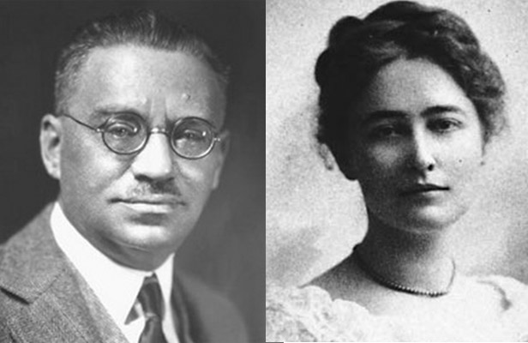
2012
Notes:
MM is also a dynamical model, though you can’t see it here.

Slide 8
2012
Impact: The model provided evidence for something previously unseen– the enzyme-substrate complex!
A theoretical entity explained the data in such a compelling way that biochemists adopted the theory for studying all enzymes. Michaelis and Menten used mathematics to show us how to think about enzymes. The theory worked so well that biochemists used it without confirmation for thirty years. The first person to confirm the existence of enzyme–substrate complexes was Britton Chance (Chance, 1943), who, no less than 30 years after Michaelis and Menten, developed the stopped-flow techniques needed to isolate intermediate complexes and measure binding and unbinding rates (Anderson, 2003).
Notes:
Background: Michaelis and Menten sought to explain the dependence of the rate of product formation on substrate concentration in enzymatic reactions. They considered a simplified reaction scheme and derived a formula that fit well to the experimental data….

Slide 9
2012
…The strange thing, however, is that there is no pH dependence in their model. Hydrogen ion concentration nowhere appears as a variable; the buffers are not mentioned, and none of the rates, or other parameters, is assumed to depend on pH. The model, in other words, is not at all a realistic description of what was actually going on in the test tube, nor is it a realistic description of a reversible enzyme. However, it is impeccably accurate at describing what was measured. We deduce something rather interesting from this. Models are not descriptions of reality; they are descriptions of our assumptions about reality…
It is tempting to believe that models should be determined by the reality being studied. Models are then objective constructions, similar to those that engineers use. Because they are independent of the questions being asked, they have a predictive capacity, and this capacity should get better and better by including more and more details. This is the kitchen-sink approach, greatly facilitated by megaflops of computing power. Had Michaelis and Menten followed it, their model would have had buffers and pH dependence, they would have learned nothing, and their paper would have sunk without a trace. Their second lesson reveals a different approach, one ideally suited to biology at the molecular level. Models should be determined by the questions being asked and the data that are available. This is not to say that models might not get very complicated, if there are data to constrain them (Chen et al., 2009; Beard, 2011)—just that they remain contingent.

Slide 10

2012
…The strange thing, however, is that there is no pH dependence in their model. Hydrogen ion concentration nowhere appears as a variable; the buffers are not mentioned, and none of the rates, or other parameters, is assumed to depend on pH. The model, in other words, is not at all a realistic description of what was actually going on in the test tube, nor is it a realistic description of a reversible enzyme. However, it is impeccably accurate at describing what was measured. We deduce something rather interesting from this. Models are not descriptions of reality; they are descriptions of our assumptions about reality…
It is tempting to believe that models should be determined by the reality being studied. Models are then objective constructions, similar to those that engineers use. Because they are independent of the questions being asked, they have a predictive capacity, and this capacity should get better and better by including more and more details. This is the kitchen-sink approach, greatly facilitated by megaflops of computing power. Had Michaelis and Menten followed it, their model would have had buffers and pH dependence, they would have learned nothing, and their paper would have sunk without a trace. Their second lesson reveals a different approach, one ideally suited to biology at the molecular level. Models should be determined by the questions being asked and the data that are available. This is not to say that models might not get very complicated, if there are data to constrain them (Chen et al., 2009; Beard, 2011)—just that they remain contingent.
Arturo Rosenblueth, the physiologist who was one of the co-founders with Norbert Weiner of cybernetics, hit the nail on the head when he quipped, “the best model of a cat is another cat, preferably the same cat.” Michaelis and Menten tell us not to worry; that is life. By making the right assumptions, a model may still be accurate and useful, even when it is not a cat.

Slide 11

On Exactitude in Science Jorge Luis Borges, Collected Fictions, 1946
…In that Empire, the Art of Cartography attained such Perfection that the map of a single Province occupied the entirety of a City, and the map of the Empire, the entirety of a Province. In time, those Unconscionable Maps no longer satisfied, and the Cartographers Guilds struck a Map of the Empire whose size was that of the Empire, and which coincided point for point with it. The following Generations, who were not so fond of the Study of Cartography as their Forebears had been, saw that that vast Map was Useless, and not without some Pitilessness was it, that they delivered it up to the Inclemencies of Sun and Winters. In the Deserts of the West, still today, there are Tattered Ruins of that Map, inhabited by Animals and Beggars; in all the Land there is no other Relic of the Disciplines of Geography.
Notes:
Similar idea to the cat quote…

Slide 12

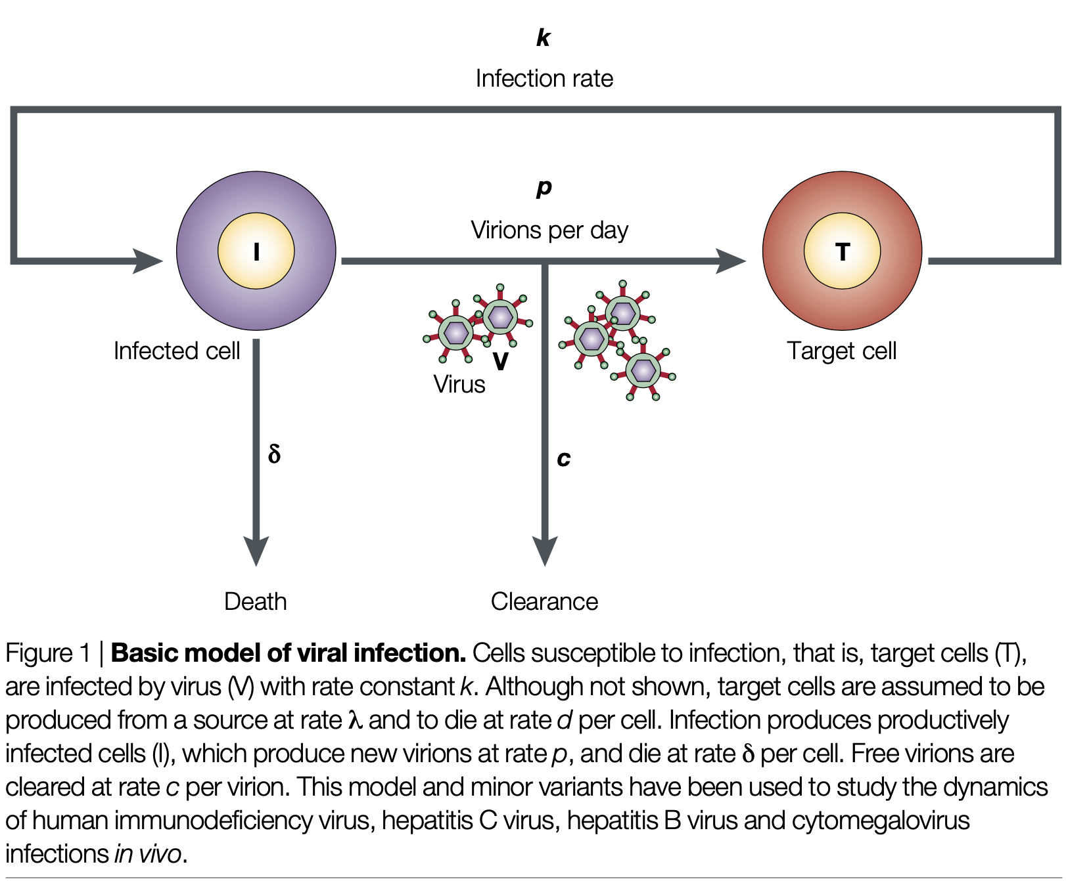
A couple of other historical success stories of dynamic models…
Uncovering & quantifying rapid virus turnover
1995
From Perelson, Nature Reviews Immunology 2002
Notes:
If a patient with
chronic HIV infection is repeatedly sampled and the
viral load in plasma measured, the viral load generally
remains unchanged. This suggested that the rate of HIV
replication was very slow. During Phase I/II clinical trials of one of the first HIV-1 protease inhibitors, ritonavir, in
chronic HIV patients (mean CD4 COUNT = 180), the
plasma level of HIV-1 RNA was observed to drop by
one to two orders of magnitude during the first 2 weeks
of therapy18–20. Although this, as well as earlier observa-
tions, indicated that the virus might be replicating
rapidly, modelling the effects of drug therapy was able to
quantify rates of virus production and loss, and indi-
cated two important points. First, HIV-1 is cleared from
chronically infected patients at a rapid rate, with the
half-life of the virus in plasma estimated in this case to
be 6 hours or less20. Second, to maintain a constant (or
steady-state) level of virus in the plasma before therapy
required that HIV-1 be produced at a rapid rate in these
patients, with, on average, at least 1010 virions being pro-
duced daily20. The experimental observations and quan-
titative estimates that followed strongly supported the
idea that HIV-1 was a rapidly reproducing virus and one
that could respond to therapy21,22. Furthermore, at the
predicted rate of rapid HIV-1 production, one could
mathematically show that during HIV-1 replication
every single possible point mutation of the viral genome
would be made hundreds or thousands of times each
day21,23. So, modelling indicated that the virus could
quickly become resistant to any single drug, particularly
those that required one mutation to generate resistance.

Slide 13
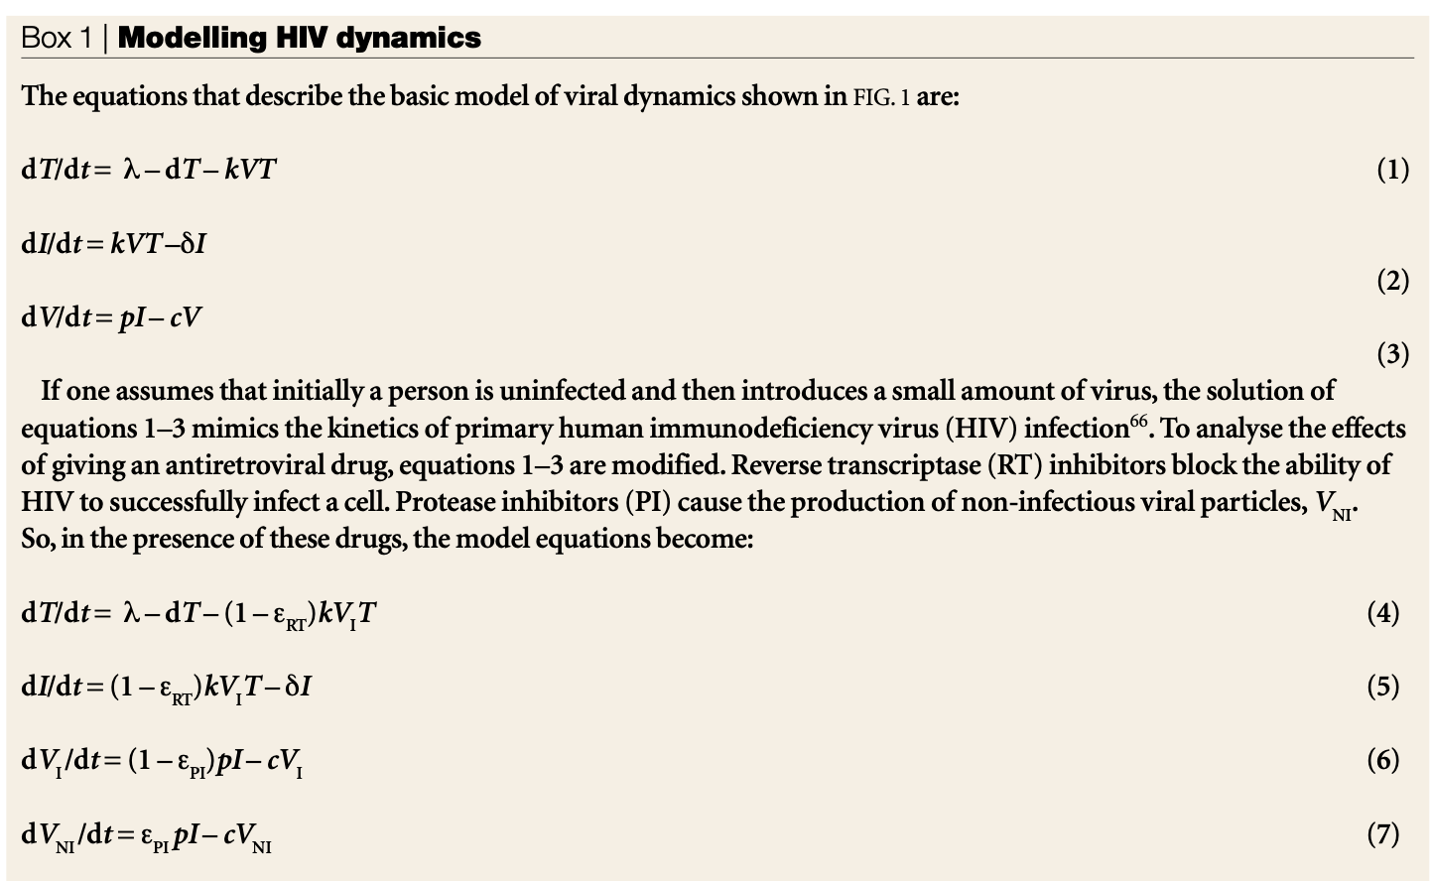
A couple of other historical success stories of dynamic models…
Uncovering & quantifying rapid virus turnover
1995
From Perelson, Nature Reviews Immunology 2002
Notes:
If a patient with
chronic HIV infection is repeatedly sampled and the
viral load in plasma measured, the viral load generally
remains unchanged. This suggested that the rate of HIV
replication was very slow. During Phase I/II clinical trials of one of the first HIV-1 protease inhibitors, ritonavir, in
chronic HIV patients (mean CD4 COUNT = 180), the
plasma level of HIV-1 RNA was observed to drop by
one to two orders of magnitude during the first 2 weeks
of therapy18–20. Although this, as well as earlier observa-
tions, indicated that the virus might be replicating
rapidly, modelling the effects of drug therapy was able to
quantify rates of virus production and loss, and indi-
cated two important points. First, HIV-1 is cleared from
chronically infected patients at a rapid rate, with the
half-life of the virus in plasma estimated in this case to
be 6 hours or less20. Second, to maintain a constant (or
steady-state) level of virus in the plasma before therapy
required that HIV-1 be produced at a rapid rate in these
patients, with, on average, at least 1010 virions being pro-
duced daily20. The experimental observations and quan-
titative estimates that followed strongly supported the
idea that HIV-1 was a rapidly reproducing virus and one
that could respond to therapy21,22. Furthermore, at the
predicted rate of rapid HIV-1 production, one could
mathematically show that during HIV-1 replication
every single possible point mutation of the viral genome
would be made hundreds or thousands of times each
day21,23. So, modelling indicated that the virus could
quickly become resistant to any single drug, particularly
those that required one mutation to generate resistance.

Slide 14
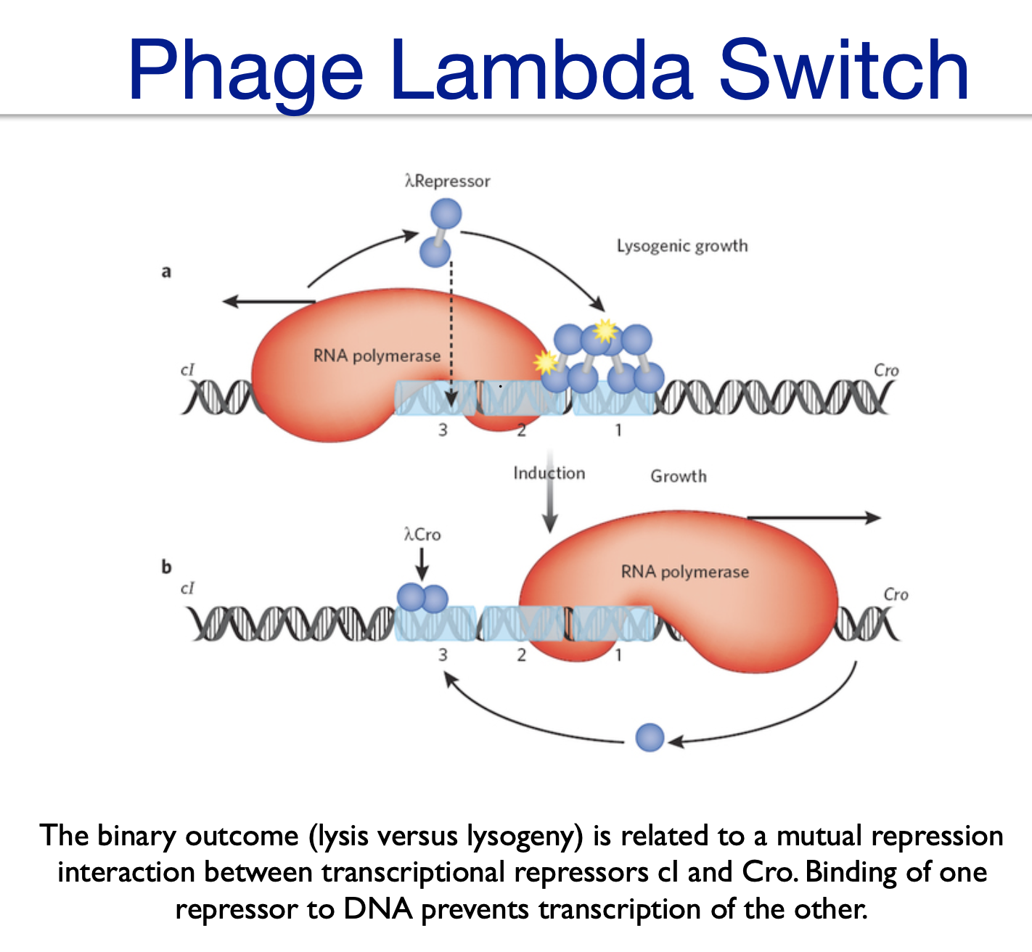
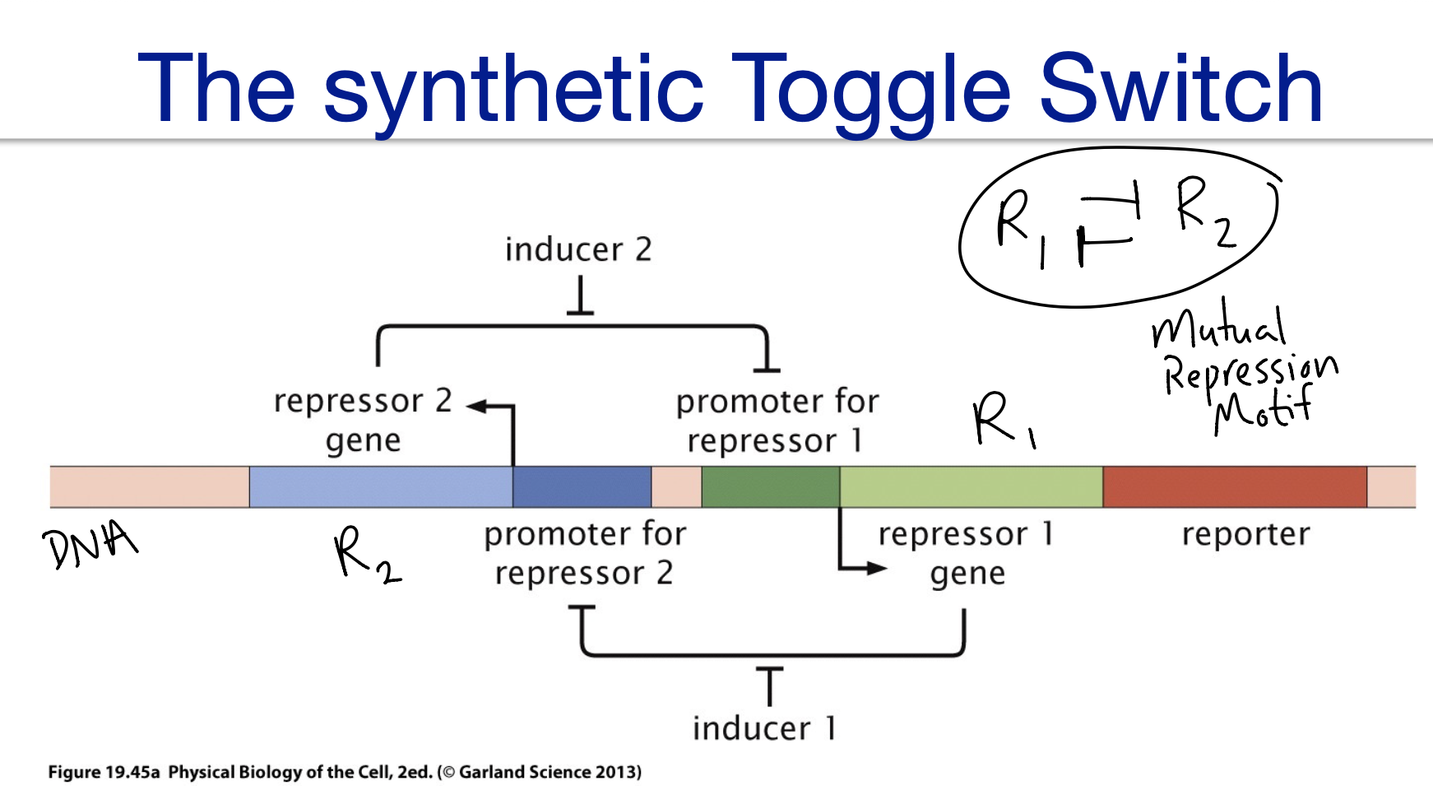

A couple of other historical success stories of dynamic models…
Using dynamic models to design synthetic gene circuits
2000
Notes:
If a patient with
chronic HIV infection is repeatedly sampled and the
viral load in plasma measured, the viral load generally
remains unchanged. This suggested that the rate of HIV
replication was very slow. During Phase I/II clinical trials of one of the first HIV-1 protease inhibitors, ritonavir, in
chronic HIV patients (mean CD4 COUNT = 180), the
plasma level of HIV-1 RNA was observed to drop by
one to two orders of magnitude during the first 2 weeks
of therapy18–20. Although this, as well as earlier observa-
tions, indicated that the virus might be replicating
rapidly, modelling the effects of drug therapy was able to
quantify rates of virus production and loss, and indi-
cated two important points. First, HIV-1 is cleared from
chronically infected patients at a rapid rate, with the
half-life of the virus in plasma estimated in this case to
be 6 hours or less20. Second, to maintain a constant (or
steady-state) level of virus in the plasma before therapy
required that HIV-1 be produced at a rapid rate in these
patients, with, on average, at least 1010 virions being pro-
duced daily20. The experimental observations and quan-
titative estimates that followed strongly supported the
idea that HIV-1 was a rapidly reproducing virus and one
that could respond to therapy21,22. Furthermore, at the
predicted rate of rapid HIV-1 production, one could
mathematically show that during HIV-1 replication
every single possible point mutation of the viral genome
would be made hundreds or thousands of times each
day21,23. So, modelling indicated that the virus could
quickly become resistant to any single drug, particularly
those that required one mutation to generate resistance.

Slide 15
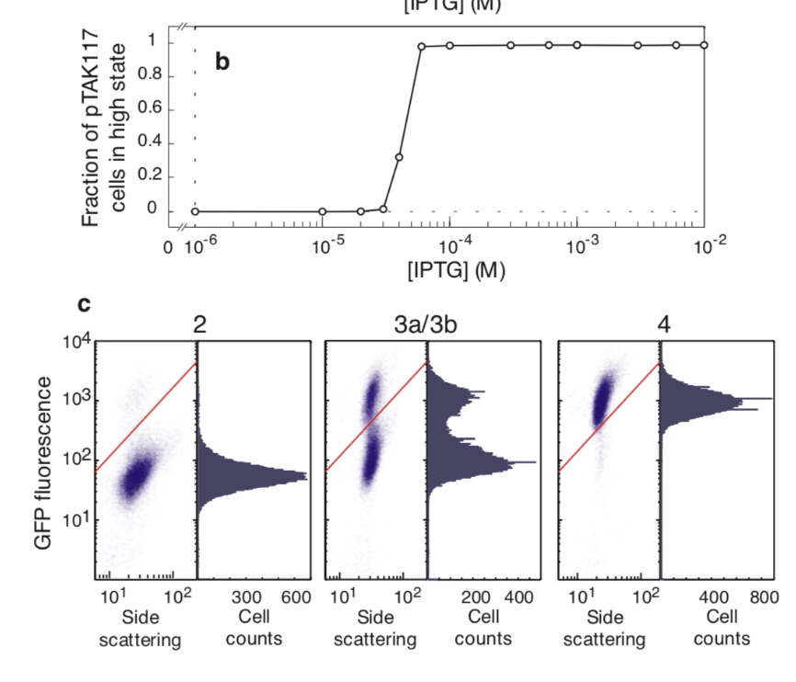
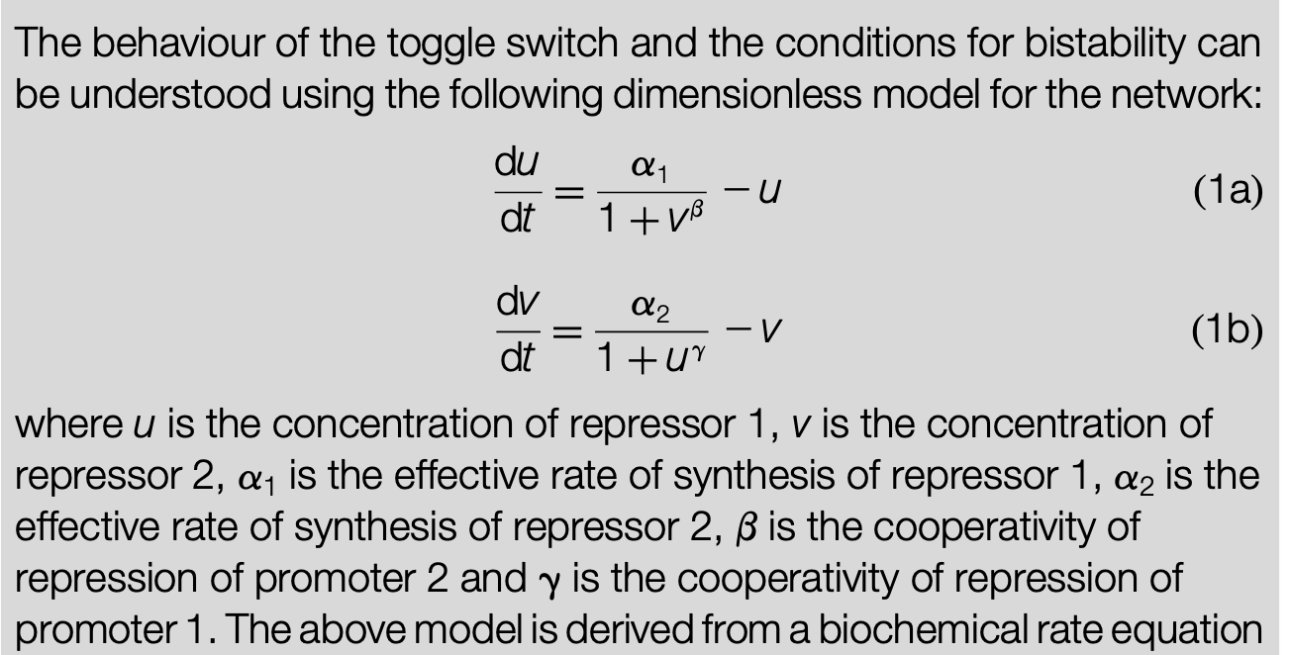
A couple of other historical success stories of dynamic models…
Using dynamic models to design synthetic gene circuits
2000
Notes:
If a patient with
chronic HIV infection is repeatedly sampled and the
viral load in plasma measured, the viral load generally
remains unchanged. This suggested that the rate of HIV
replication was very slow. During Phase I/II clinical trials of one of the first HIV-1 protease inhibitors, ritonavir, in
chronic HIV patients (mean CD4 COUNT = 180), the
plasma level of HIV-1 RNA was observed to drop by
one to two orders of magnitude during the first 2 weeks
of therapy18–20. Although this, as well as earlier observa-
tions, indicated that the virus might be replicating
rapidly, modelling the effects of drug therapy was able to
quantify rates of virus production and loss, and indi-
cated two important points. First, HIV-1 is cleared from
chronically infected patients at a rapid rate, with the
half-life of the virus in plasma estimated in this case to
be 6 hours or less20. Second, to maintain a constant (or
steady-state) level of virus in the plasma before therapy
required that HIV-1 be produced at a rapid rate in these
patients, with, on average, at least 1010 virions being pro-
duced daily20. The experimental observations and quan-
titative estimates that followed strongly supported the
idea that HIV-1 was a rapidly reproducing virus and one
that could respond to therapy21,22. Furthermore, at the
predicted rate of rapid HIV-1 production, one could
mathematically show that during HIV-1 replication
every single possible point mutation of the viral genome
would be made hundreds or thousands of times each
day21,23. So, modelling indicated that the virus could
quickly become resistant to any single drug, particularly
those that required one mutation to generate resistance.

Slide 16

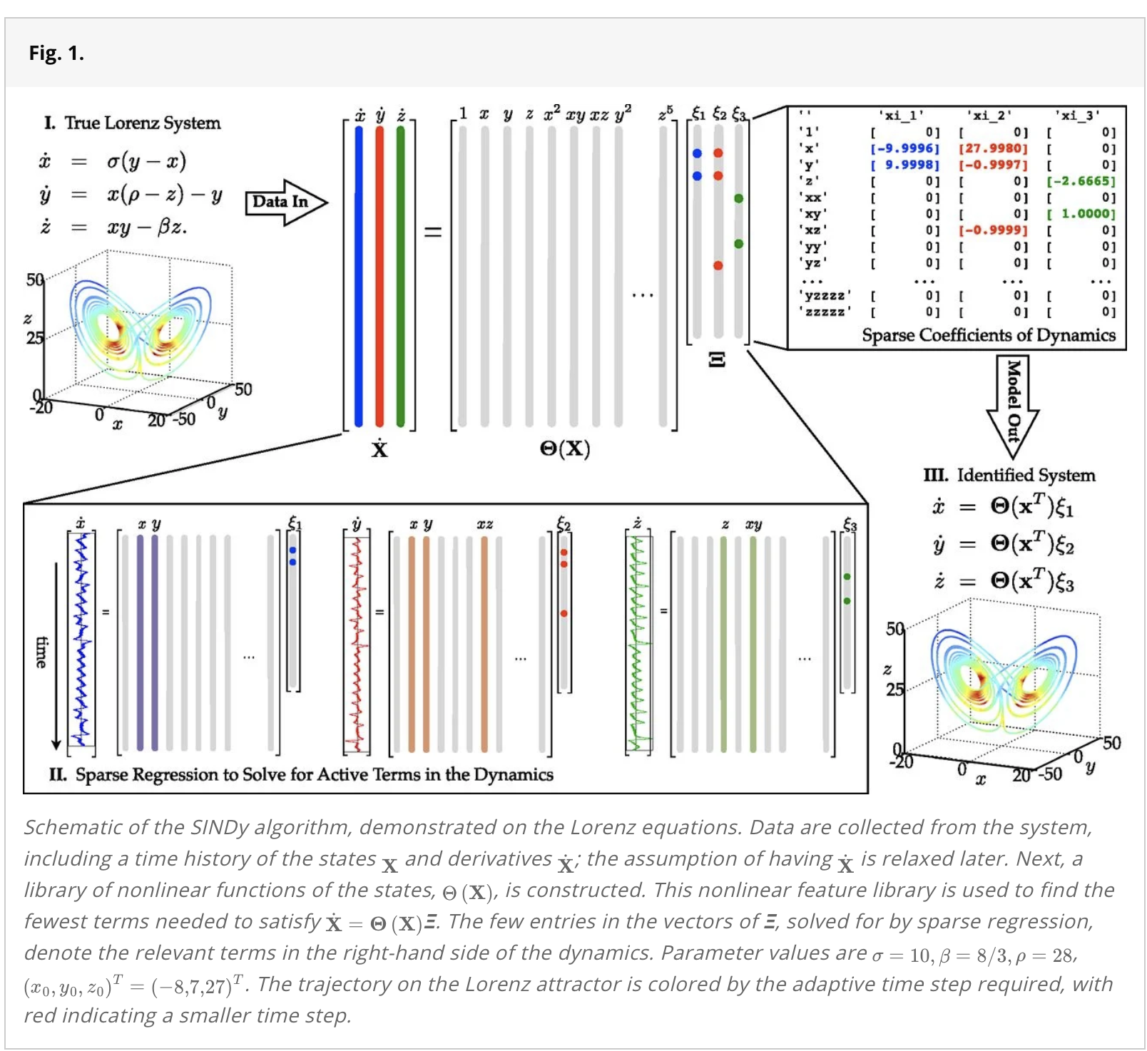
Dynamic Models in the Age of AI/ML - SINDy
2016
Notes:
Cited by > 5000 since 2016!

Slide 17
Dynamic Models in the Age of AI/ML - SINDy
2016
Understanding dynamic constraints and balances in nature has facilitated rapid development of knowledge and enabled technology, including aircraft, combustion engines, satellites, and electrical power. This work develops a novel framework to discover governing equations underlying a dynamical system simply from data measurements, leveraging advances in sparsity techniques and machine learning. The resulting models are parsimonious, balancing model complexity with descriptive ability while avoiding overfitting. There are many critical data-driven problems, such as understanding cognition from neural recordings, inferring climate patterns, determining stability of financial markets, predicting and suppressing the spread of disease, and controlling turbulence for greener transportation and energy. With abundant data and elusive laws, data-driven discovery of dynamics will continue to play an important role in these efforts.
Notes:
Cited by > 5000 since 2016!

Slide 18
Computational Exercises
Language is up to you! (I can help you if Python or MATLAB, I have some scripts to get you started in Python, MATLAB, R)
If you have software installed locally on your laptop, you can write and run your scripts locally
Other options:
Jupyter server on HPC: https://rcic.uci.edu/slurm/examples.html#jupyterhub-portal
Login (w UCINet ID) at matlab.mathworks.com ➞ MATLAB Online
If you’re not sure what language/platform, let’s chat!

Slide 19
Teams and Deliverables
Team Formation: TBD
Instructions:
Work through the exercises with your team. I recommend coding separately, but helping each other. That is, no team member should get much ahead of the others.
Deliverables: Show me your progress as I walk around (short answer, sketches, graphs). I’ll check off each team’s progress.

Slide 20
Are you familiar with the discrete logistic growth model?
[0,1, 2]
[Not at all, A little/somewhat, Yes]

